Slide 1
LENDING CLUB CASE STUDY
By:
Group Facilitator: Abhishek
Group Member: Rishabh Anand

Slide 2
Steps involved while analyzing case study.
The case study is based upon the Exploratory Data Analysis methods.
The steps involved in this are:
A) Data Sourcing : To store the data into data frame from a file source.
B) Data Cleaning : This involves cleaning out the unwanted columns and data that are present in the file like (NA, 0.00, 16.2+E).
The data cleaning also involves filtering out of the data which are categorically placed inside a column like ( using integer value for years column)
C) The Data filtering or standardization of data gives a clear picture of plotting the graph based upon a certain value.
D) Data Plotting : Involves the plotting of graph(box plot, univariate analysis, bi variate analysis)

Slide 3
DATA TAKEN FOR ANALYSIS
After filtering, cleaning and standardizing the data we came up with the below details for our analysis.
a) Loan_amnt
b) Funded_amnt_inv
c) Terms_In_Months
d) Int_rate
e) EMI
f) Grade
g) sub_grade
h) emp_length
i) home_ownership
j) Annual_Income
k) verification_status
l) loan_status
m) Purpose

Slide 4

GRAPHS

Slide 5
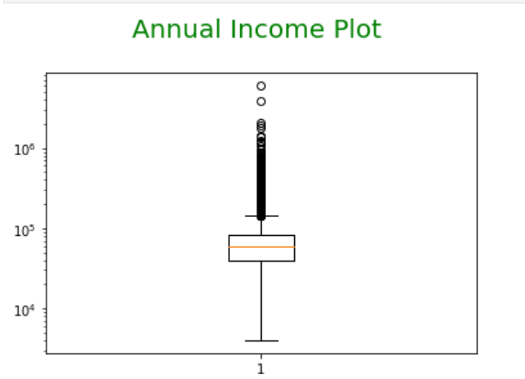
Annual Income Graph(BOX PLOT)
This graph shows the annual income of the borrower who have applied for the loan. This is an important plot to understand that the people with higher income tend to be more liable to pay the loan amount. Thus the bank has more trust on the people having higher income.

Slide 6
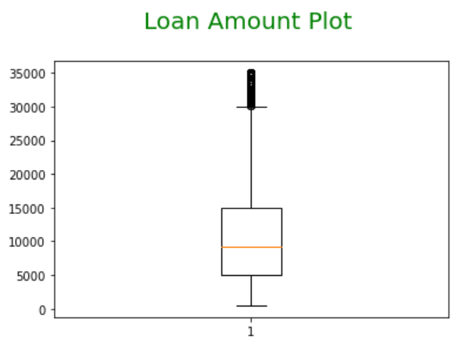
LOAN AMOUNT GRAPH (BOX PLOT)
This box plot shows the loan amount that a person goes and apply in a bank. It is observed that the higher loan amount tends to be having more Emi. Thus this plot relates with the annual income so a person with higher income may opt for a bigger loan amount.

Slide 7
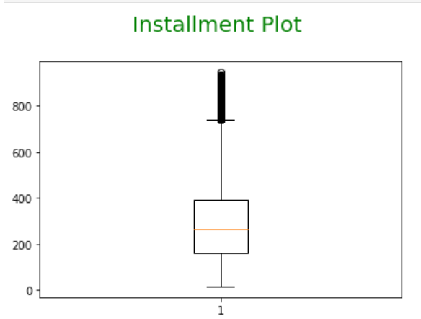
Installment Plot( Box Plot)
The installment plot also refer as EMI is useful predictor to tell us the liable EMI generated against the loan amount funded. This parameter can be a tool to attract the borrowers to purchase loan at less interest rate with lower EMI.

Slide 8
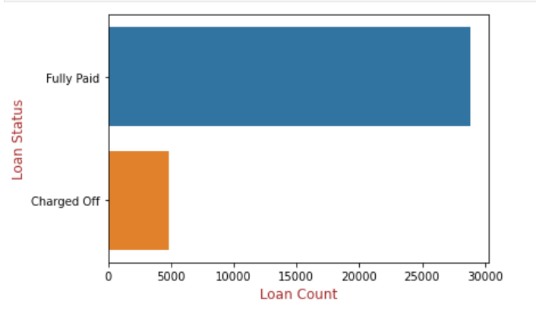
UNIVARIATE ANALYSIS
This is an excellent approach to find out that a person having an emi of 25k to 30k per month is liable to fully pay the amount. This also tells that the bank in certain cases where the emi is less than 5K is liable to be charged off or subsidized. This can be a classic example of a low wage earner taking loan vs an employee working in the high paid job. Thus a low wage earner can also avail the benefits of loan with a lesser interest rate and can be liable to be waved off from the EMI.

Slide 9
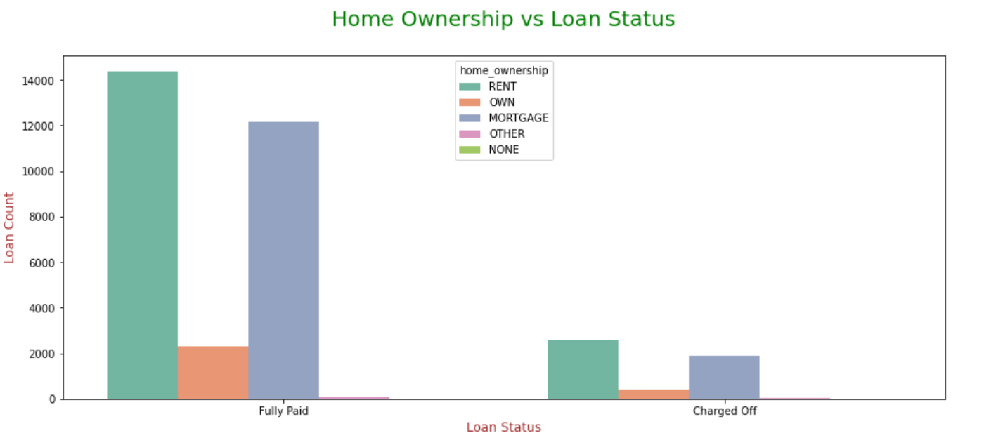
HOME OWNERSHIP vs LOAN_STATUS (UNIVARIATE ANALYSIS)
From this analysis it is clear that the Rent people tend to move more towards the loan compared to the people who owns there property.

Slide 10
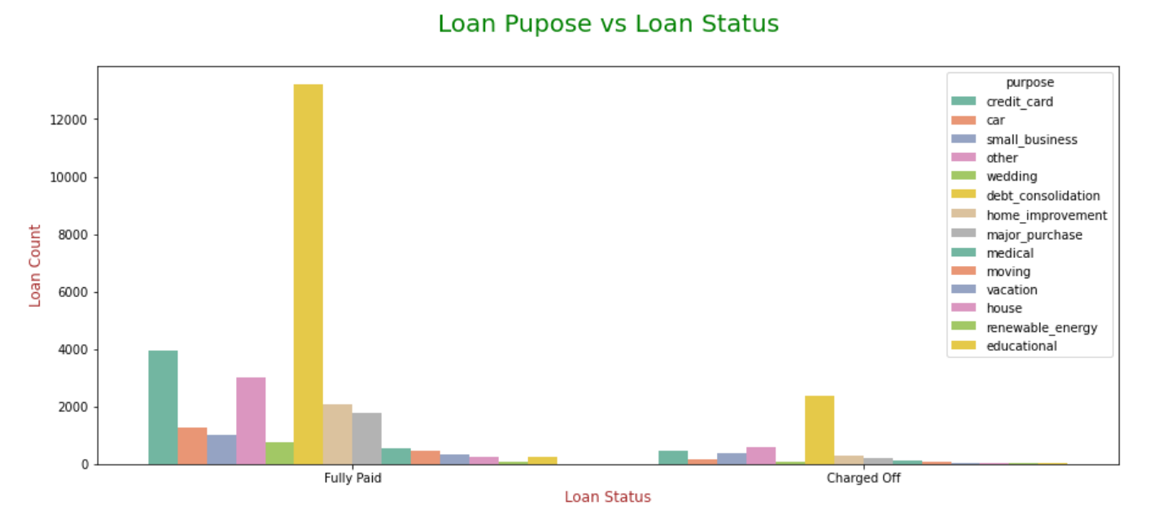
LOAN PURPOSE VS LOAN STATUS
This indicator tells that debt_consolidation holds more value. Also the educational loan has more charged off facility as compared to other the EMI ranges between 2000-4000.

Slide 11
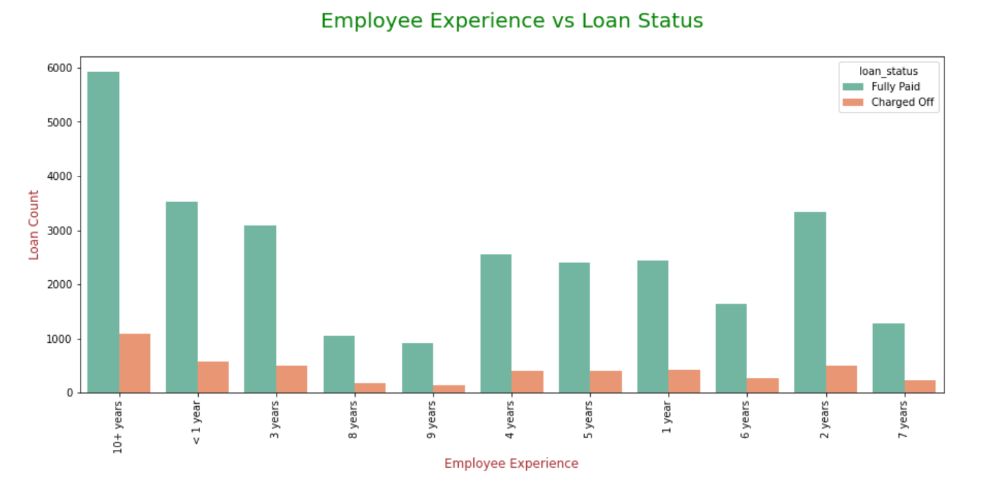
This graph shows that the employee with more experience tend to fully pay the loan. So an experience employee will have a high chance of being in non defaulter list.

Slide 12
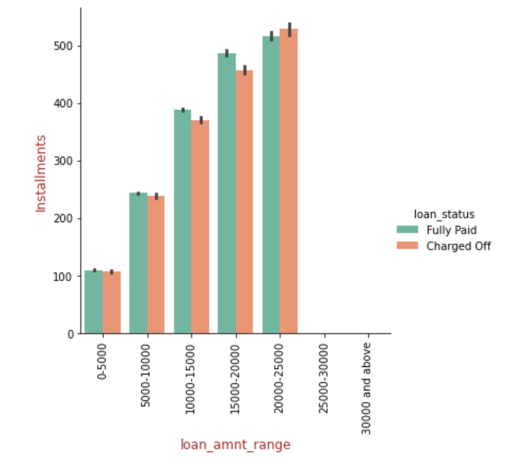
BIVARIATE ANALYSIS
This catplot analysis of Installment vs Loan_amnt_range tells that the installment or the emi when lies between 20000 tends to get fully paid also the charged of amount varies to certain extent in the graph.

Slide 13
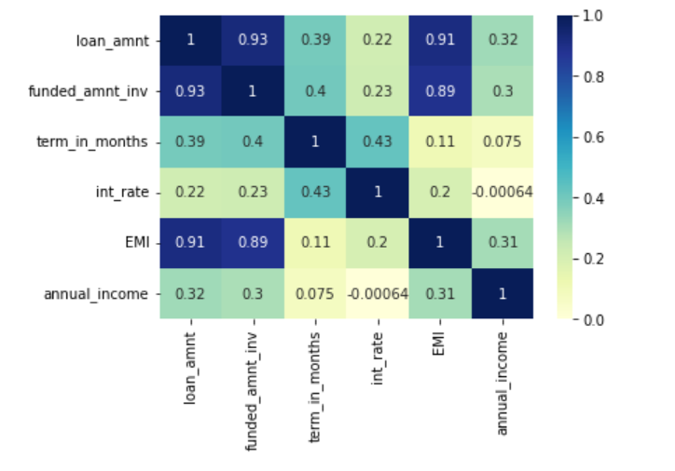
CORRELATION GRAPH
This example shows the data plot in terms of all the relevant criteria being used. The correlation of the loan amount with the annual income suggest that annual income if being on higher side tend to help in paying the loan more easily.

